Slide 1
ADATIS
Development of a robust ethics framework for an industry leading data analytics consultancy company.
BEMM457J : Topics in Business Analytics
Module Leader – Dr. Salimeh Pour Mohammad
Notes:
Group 13 project

Slide 2
Topics of Discussion
About Adatis
▪ Data ethics and its Importance in digital economy
▪ Emerging global ethical initiatives ▪ Industry Specific initiatives for data ethics
Adatis and its competition
▪ Microsoft Azures principles of responsible innovation ▪ Microsoft data policies
▪ Accenture's ethical framework ▪ Government of UK ethical framework
Review of ethical frameworks
▪ Adatis data ethics framework blueprint ▪ Recommendations for Adatis
▪ Conclusion
Responsible innovation

Slide 3


About Adatis
Adatis specializes in the fields of:
Adatis provides data driven solutions and services in:
Fig -1 : The Adatis Company Logo
Professional Services
Advanced Data Analytics
Data Management Strategy and Consultancy
Fig -2 : Microsoft Gold Certified Partner
Retail & Consumer goods
Financial Services
Healthcare
Government
Education
Hospitality
Media & Entertainment
Manufacturing
Founded in 2006, headquarters at Farnham, Surrey
Awarded Microsoft Gold Certified Partner Status in 2008
Acquired by Incremental group in October 2021
7 Offices across the globe.

Slide 4
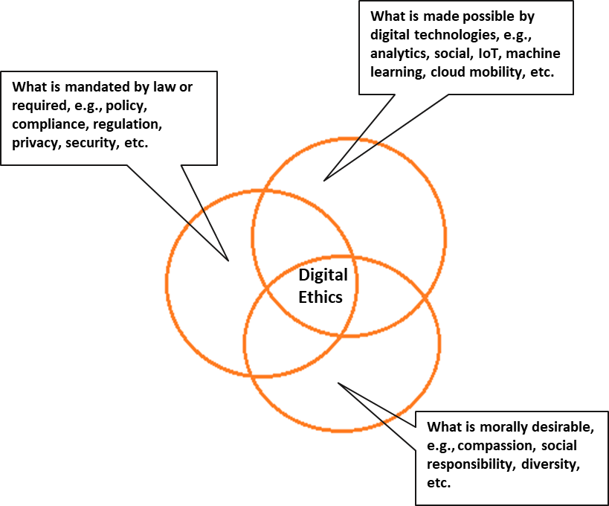
Data Ethics
The UK Government defines data ethics or a data ethics framework as a “set of principles to guide the design of appropriate data use in the public sector. It is aimed at data practitioners, policy makers, operational staff and people helping to produce data informed insight”
Fig -3 : Digital Ethics and its surrounding question

Slide 5
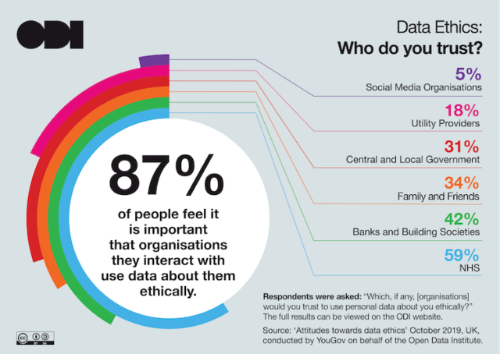
Importance of Ethics in the Digital Economy
9.7 billion records were lost or stolen worldwide since 2013 – Deloitte report.
more than 95,000 complaints have been received from data protection authorities under the EU GDPR Act since its launch.
Augmented reality raises several ethical grey areas such as differentiating which aspects of the experience are real.
As the digital economy develops, digital ethics plays an important role in the technological transformation of organizations. It strives to act responsibly for the benefit of everyone, including the company itself.
Fig -4 : Data Ethics Infographic for 2019 ((Nearly 9 in 10 people think it’s important that organisations use personal data ethically – The ODI, n.d.))

Slide 6
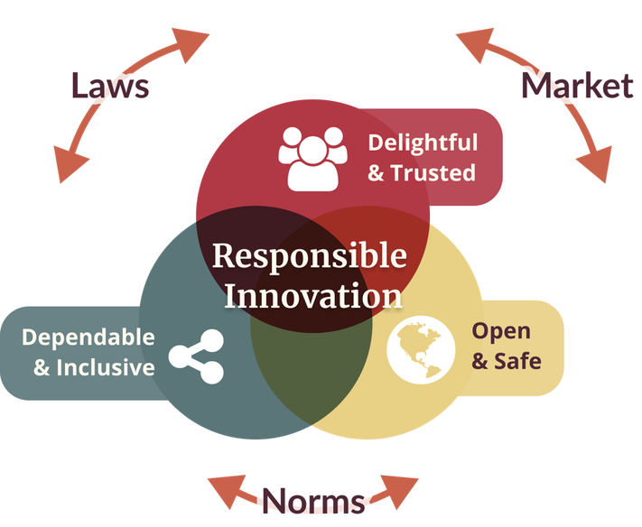
Responsible Innovation
Responsible innovation is a process that takes the wider impacts of research and innovation into account, creating change that has positive impacts and avoided any potential downsides on society and the environment. (Responsible innovation, n.d.)
Fig -5 : Responsible innovation process

Slide 7

Principles of Responsible Innovation
Responsible innovation, regardless of scale, source and technology, balances responsibility and purpose, with pace and agility.
This is driven by the six principles of responsible innovation:
Purpose-led
Stakeholder centricity
Inclusive collaboration
Risk mitigation & opportunity spotting
Through-life impact
Transparency

Slide 8
Emerging Global Ethical Initiatives
The Council for Big Data, Ethics, and Society was started in 2014 to provide critical social and cultural perspectives on big data initiatives.
The European Union’s General Data Protection Regulation (GDPR) was formed in 2018 to monitor organizations that process personal data of EU individuals, regardless of whether the organization has a physical presence in the EU.
Serbia’s National Assembly enacted a new data protection law modeled after GDPR
Hong Kong published an ethical accountability framework that includes guidelines for protecting the privacy of citizens
Bahrain passed a data protection law making it the first Middle Eastern country to adopt a comprehensive privacy law.
Canada has developed an open-source Algorithmic Impact Assessment to help ensure decisions made by automated systems are interpretable and transparent.
The city of New York has established an automated decision systems task force to explore how the city uses algorithms to make decisions.
The Netherlands has developed a data ethics decision aid tool that is currently used by various Dutch municipalities to make ethical decisions related to data.

Slide 9


Industry Specific initiatives for Data Ethics
Deloitte emphasizes the importance of the rise of AI and Data Ethics in the Deloitte Insights’ Government Trends 2020 report. (Deloitte insights - Government trends, 2020)
The Tech industry is taking a responsible lead to set up advance systems of understanding of AI Technologies
Fig -6 : Deloitte Insights of Government trends

Slide 10
Adatis and its competition
Agile Analytics We consult, design, and deliver tailored data analytics and technology solutions to mid-to-large-sized organizations worldwide.
Data Bear Provides Data Warehousing & Power BI Solutions that Produce results with a vertical focus on delivering robust modern analytics
All the firms included are partners of Microsoft we will study the existing data ethics and responsible innovation of Microsoft

Slide 11

Microsoft Azure's Principles of Responsible Innovation
Accountability
People who design and deploy AI Systems must be accountable for how their systems operate.
Transparency
AI Systems Should be Understandable.
Fairness
AI Systems should treat all people fairly.
Reliability and safety
AI Systems should perform reliably and safely.
Security and privacy
AI Systems should be secure and respect privacy.
Inclusiveness
Address a broad range of human needs and experiences
Fig -7 : Microsoft Azure

Slide 12
Microsoft Data Policy
How we use your Data
Microsoft does not provide any government with direct and unfettered access to our customers’ data, and we do not provide any government with our encryption keys or the ability to break our encryption.​
If a government wants customer data, it must follow applicable legal process. It must serve us with a warrant or court order for content, or a subpoena for subscriber information or other non content data.​
All requests must target specific accounts and identifiers.​
Microsoft’s legal compliance team reviews all requests to ensure they are valid, rejects those that are not valid, and only provides the data specified.

Slide 13
Accenture’s Ethical Framework
1.The highest priority is to respect the persons behind the data.
2.Account for the downstream uses of datasets.
3.The consequences of utilizing data and analytical tools today are shaped by how they’ve been used in the past.
4.Seek to match privacy and security safeguards with privacy and security expectations.
5.Always follow the law but understand that the law is often a minimum bar.
6.Be wary of collecting data just for the sake of having more data.
7.Data can be a tool of both inclusion and exclusion.
8.As far as possible, explain methods for analysis and marketing to data disclosers.
9.Data scientists and practitioners should accurately represent their qualifications (and limits to their expertise), adhere to professional standards, and strive for peer accountability.
10.Aspire to design practices that incorporate transparency, configurability, accountability, and auditability.
11.Products and research practices should be subject to internal (and potentially external) ethical review.
12. Governance practices should be robust, known to all team members and regularly reviewed.

Slide 14
Accenture Ethical Framework Review
Deriving from the principles of Responsible Innovation, we evaluate Accenture's ethical framework as follows:
Principles of Responsible Innovation | Does the Accenture's Ethical Framework follow?
1. Purpose Led | YES
2. Stakeholder Centricity | NO
3. Inclusive collaboration | YES
4. Risk mitigation and opportunity spotting | YES
5. Through-life impact | NO
6. Transparency | YES

Slide 15

Government of UK Ethical Framework
1) A framework designed for public companies on how to use data responsibly while building company policies
2) Defines public benefit and user need
3) Involve diverse expertise
4) Comply with the law
5) Review the quality and limitations of the data
6) Evaluate and consider wider policy implications
Fig -8 : Government of United Kingdom domain

Slide 16
Government of UK Ethical Framework Review
Deriving from the principles of Responsible Innovation, we evaluate the Government of UK ethics frameworks as follows:
Principles of Responsible Innovation | Does the UK GOV’s Ethical Framework follow?
1. Purpose Led | YES
2. Stakeholder Centricity | YES
3. Inclusive collaboration | YES
4. Risk mitigation and opportunity spotting | YES
5. Through-life impact | NO
6. Transparency | NO

Slide 17
Adatis Data Ethics Framework Blueprint
Prioritize the Safety of Users
Accounting Potential Misuse
Tracking the entire method of obtaining the data
Quality and Accuracy of Data
Security Expectations of Users
Law is often a minimum bar
Explain the Methods for Analysis and Marketing the Data
Accurate representation of the qualifications of Data Professionals
Incorporate Transparency, Accountability, Configurability, Auditability.
Internal and External Ethical Review
Team should be regularly informed about governance practices
Consulting users throughout the innovation process
Considering a Long-Time Frame
Self-assessment scores for data practices.

Slide 18

Recommendations for Adatis
Information on Cookies
Ethics committee
Adding ethical framework on the website
Events and newsletters
While using the company website, customers should be informed of the various data policies used while using various browser cookies and how they use this data appropriately.
An executive team of ethics officers and policy makers can be formed in order to understand and continually develop on the data ethics practices within the company, so they stay in line with the government and standard practices of the industry
This will provide transparency for all the employees, clients and stakeholders of Adatis about how they company follows ethical practices
An internal newsletter for the employees will provide adequate information regarding how the company adheres be the data policies set for progress.

Slide 19
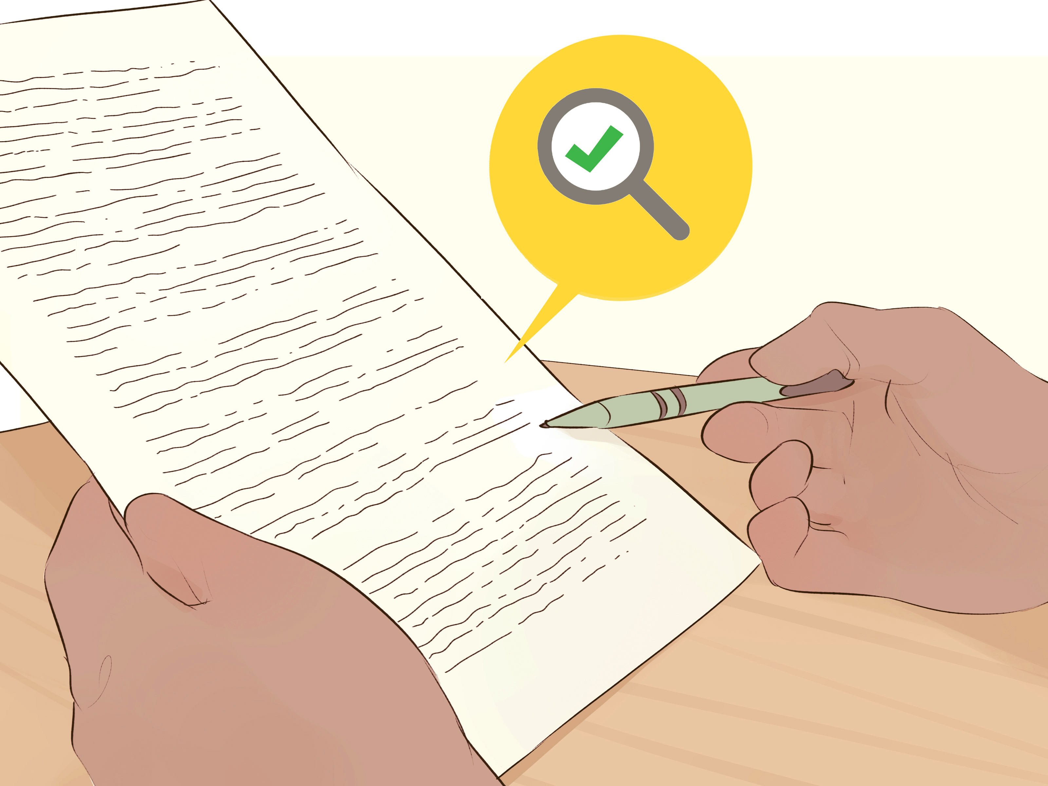
Conclusion
Compared industry leading ethical frameworks
Developed an appropriate data ethics framework for Adatis
Suggested four recommendations for the company to be proficient in data ethics and abide by set policies

Slide 20
References
Responsible innovation. (n.d.). www.ukri.org. https://www.ukri.org/about-us/policies-standards-and-data/good-research-resource-hub/responsible-innovation/
Data Ethics Framework. (n.d.). https://assets.publishing.service.gov.uk/government/uploads/system/uploads/attachment_data/file/923108/Data_Ethics_Framework_2020.pdf
‌Nearly 9 in 10 people think it’s important that organisations use personal data ethically – The ODI. (2019, November 12). The Open Data Institute. https://theodi.org/article/nearly-9-in-10-people-think-its-important-that-organisations-use-personal-data-ethically/
Responsible Innovation Framework. (2020, September 23). Business in the Community. https://www.bitc.org.uk/report/responsible-innovation-framework/
Council for Big Data, Ethics, and Society. (2016, April 24). Datasociety.net. https://bdes.datasociety.net/
Communications, U. (2020, September 22). The evolution of data ethics in the public sector. Www.unit4.com. https://www.unit4.com/blog/evolution-data-ethics-public-sector
Agile Analytics. (n.d.). Agile Analytics. https://agile-analytics.com.au/
Johann. (n.d.). About Us | More Information - Data Bear. Data Bear - Power BI Training and Consulting. https://databear.com/about-us/
Deloitte Center for Government Insights. (2019). A REPORT FROM THE DELOITTE CENTER FOR GOVERNMENT INSIGHTS Government Trends 2020 What are the most transformational trends in government today? https://www2.deloitte.com/content/dam/insights/us/articles/government-trends-2020/DI_Government-Trends-2020.pdf
Central Digital and Data Office. (2018, June 13). Data Ethics Framework. GOV.UK. https://www.gov.uk/government/publications/data-ethics-framework/data-ethics-framework-2020
Microsoft. (n.d.). About our practices and your data. https://blogs.microsoft.com/datalaw/our-practices/
Accenture. (2016). Building digital trust: The role of data ethics in the digital age. https://apo.org.au/sites/default/files/resource-files/2016-06/apo-nid71946.pdf

